Slide 1
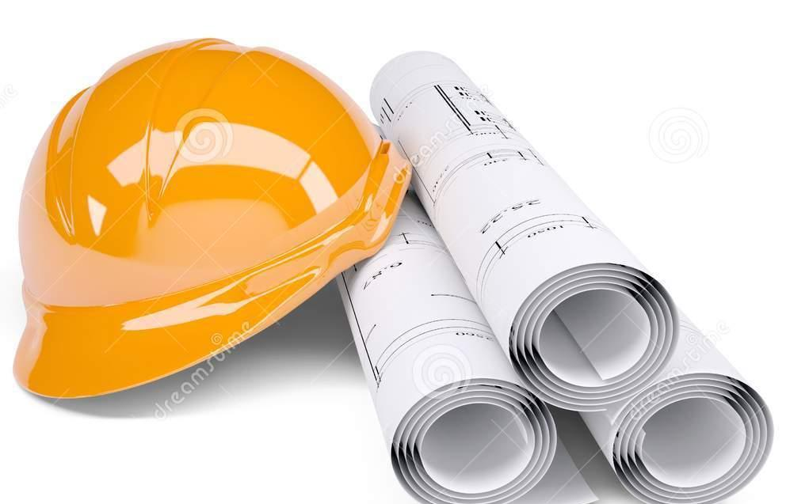
UML, Patterns and Software Quality
Algorithms and Data Structures

Slide 2
Disclaimer / Descargo de Responsabilidad
Esta presentación corresponde a una guía usada por el profesor durante las clases. La misma ha sido modificada para ser utilizado en el modelo de cursos asistidos por tecnología. No es una versión final, por lo que la misma podría requerir todavía hacer algunos ajustes. Para aspectos de evaluación esta presentación es solo una guía, por lo que el estudiante debe profundizar con el material de lectura asignado y lo discutido en clases para aspectos de evaluación.
This presentation corresponds to a guide material used by the professor during classes. It has been modified to be used in the model of technology-assisted courses. It is not a final version, so it may still require some adjustments. For evaluation aspects, this presentation is only a guide, so the student should delve with the assigned reading material and what has been discussed in class.

Slide 3
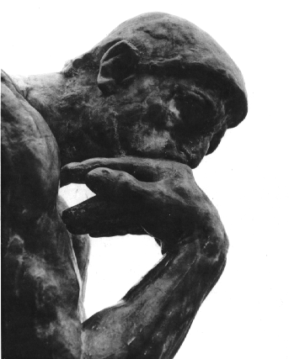
Think about it...
When you receive a project specification, what do you do?
Do you start coding right away?
Do you carefully plan everything and then code?
Do you make a balance between planning and coding?

Slide 4
Think about it...
Most people goes direct to code!
Too much design and thinking is for cowards! - they say
Kids code apps in their bedrooms!
Do you see any risk in this approach?

Slide 5
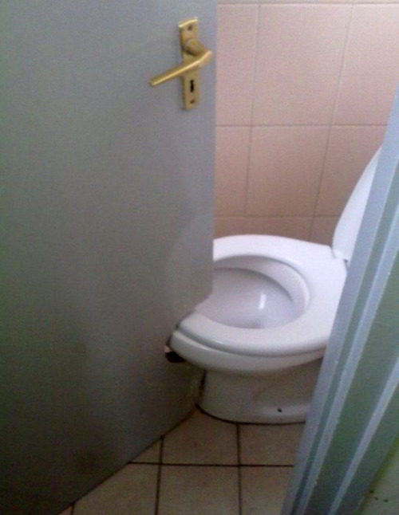
Professional vs empiric

Slide 6
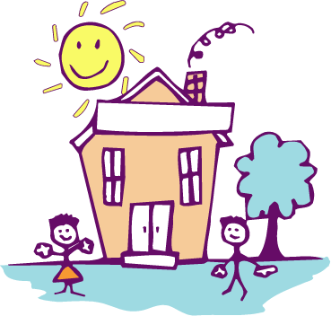
Professional vs empiric

Slide 7
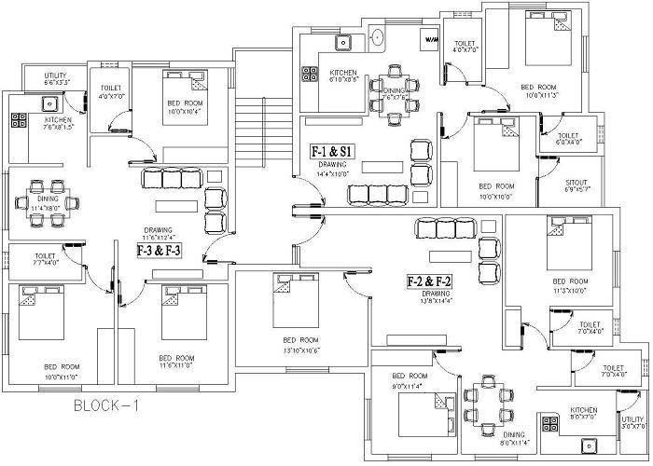
Professional vs empiric

Slide 8
For computer engineers...
There are formal ways to do ours jobs
Project management methodologies
Development methodologies
Standards and frameworks
Best practices
Tools
These are some of the things that separates an engineer from the kid coding in his room..

Slide 9
In this topic
We will focus just on:
UML
OOP
Design Patterns
Software quality
Take a guess, can you explain each of these items?

Slide 10

Before going into details...
UML has a tight relationship with the object-oriented paradigm
Let's review some OOP concepts first

Slide 11
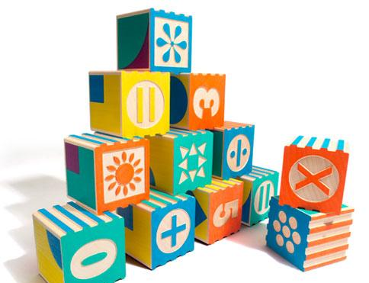
Object-Oriented Paradigm
Revisiting some definitions

Slide 12
What is an object?
An object packages data and procedures that operate on the data
Procedures are called methods and operates on the data of the object. Data is called attributes.
The only way to interact with an object is through a request or message from a client.

Slide 13
What is the interface of an object?
The internal state of an object is encapsulated: it cannot be accessed directly
A method name, parameters and return value is called the signature of the method.
The set of all signatures is the interface of the object

Slide 14
What is the interface of an object?
Signature
1 2 3 4 5 6 7 8 | public class Person { void getName(); String setName(String name); Person retrieveFromDatabase(); }

Slide 15
What is the interface of an object?
Object interface
1 2 3 4 5 6 7 8 | public class Person { void getName(); String setName(String name); Person retrieveFromDatabase(); }

Slide 16
What is the class of an object?
An object has a class. A class defines the implementation of an object
Specifies the attributes and interface of an object
Objects are created by instantiating a class.
When an instance is created, it allocates the memory of the object and associates the methods to this memory.

Slide 17
What is inheritance?
Is a way of create a new class based on an existing class.
A subclass extends a parent class, including all the definitions of the data and operations defined by the parent.
A subclass can access most of the data and operations defined by its parent

Slide 18
What is inheritance?
Is a way of create a new class based on an existing class.
A subclass extends a parent class, including all the definitions of the data and operations defined by the parten.
A subclass can access most of the data and operations defined by its parent
Except private data / operations

Slide 19
What is an abstract class?
Is a class whose main purpose is to define a common interface for its subclasses
It cannot be instantiated, only extended. The subclass of an abstract is called concrete class
An abstract class can implement some operations or not. The non-implemented are called abstract methods

Slide 20
Overriding and overloading
A subclass can override a method of the parent class. This means, replace the original method of its parent
Intercept requests instead of relying on its parent
Overloading means that a class can have more than one method with the same name but with different parameters or return value.

Slide 21

Polymorphism
Extending a class allows to override a method of the parent class
When a request for a method is issued, the association between the object and the method is done at run-time
This is called dynamic binding

Slide 22
Polymorphism
Dynamic binding allows to substitute objects that have identical interfaces for each other at run time
This substitutability is called polymorphism

Slide 23
Polymorphism
Dynamic binding allows to substitute objects that have identical interfaces for each other at run time
This substitutability is called polymorphism
Key concept in OOP

Slide 24
What is object composition?
You can reuse an object with two different approaches:
Inheritance
Composition
In inheritance you can define an object in terms of another
In composition, you can reuse functionality by assembling objects together

Slide 25
What is object composition?
You can reuse an object with two different approaches:
Inheritance
Composition
In inheritance you can define an object in terms of another
In composition, you can reuse functionality by assembling objects together
Objects instances as attributes of another

Slide 26
Coupling and Cohesion
Coupling is the degree of interdependence between two modules / classes of a system
If one class uses many methods of another concrete class, both classes are tightly coupled
If one class uses just a few methods of another concrete class, coupling lows
If the class uses methods of an interface and not uses the concrete object directly, coupling is loose.

Slide 27
Coupling and Cohesion
Cohesion is the degree to which elements of a module/class belong together
Methods inside a class have a lot in common, functionally and conceptually speaking
Methods are small and carry specific tasks, and are used to the inside of the class
Coupling should be low and cohesion should be high
Signs of a good design

Slide 28

Unified Modeling Language

Slide 29
What is UML?
UML stands for Unified Modeling Language
Standard language for writing software blueprints
The usage of UML give you a professional and standard approach to create artifacts during the SDLC

Slide 30
What is UML?
UML stands for Unified Modeling Language
Standard language for writing software blueprints
The usage of UML give you a professional and standard approach to create artifacts during the SDLC
Software Development Life Cycle

Slide 31
What is UML?
Think of UML as the formal notation for computer engineers
Just like the drawings of a house blueprint can be understood by any architect, UML can be understood by any computer engineer

Slide 32
Brief history of UML
After the arrival of the OOP, many object modeling techniques started to emerge
In the years between 1989 and 1994 at least 50 object oriented methods with different modeling languages

Slide 33
Brief history of UML
In the middle of this chaos, there were three prominent methods:
Booch
OOSE (Object Oriented Software Engineering)
OMT (Object Modeling Technique)
Each of these had strengths and weaknesses

Slide 34
Brief history of UML
The authors of these three methods joined forces to unify them in one single modeling language
Grady Booch, Ivar Jacobson and James Rumbaugh created a consortium for UML
Many companies joined this consortium:
IBM, HP, Oracle, Unisys, Texas Instruments, Microsoft, among many others

Slide 35

Brief history of UML
In 1996 the first version of UML was released
Currently the Object Management Group maintains the UML standard

Slide 36
Why modeling is necessary?
We all want to build good software, so:
We build models to communicate the desired structure and behavior of our system
We build models to visualize and control the system’s architecture
We build models to better understand the system we are building
We build models to manage risk
Is not the same to build the house of a dog to build a skyscraper

Slide 37
Why modeling is necessary?
We model because is a well-accepted engineering technique!
Constructions & Architecture
Electronics
Sociology
Economics
A model is:
A simplification of reality (Abstraction)

Slide 38
Why modeling is necessary?
UML is composed of three types of models:
Functional model
Object model
Dynamic model
Each model is composed by a set of diagrams
You will learn more about this in future courses. We will see just an overview

Slide 39
Functional model: Use cases diagram
An use case diagram captures the behavior of a system, subsystem, class or component as it appears to an outside user
It partitions the system into transactions meaningful to actors
An use case is a coherent unit of functionality expressed in terms of messages exchange by the system and the actors
Logical description of a slice of functionality

Slide 40
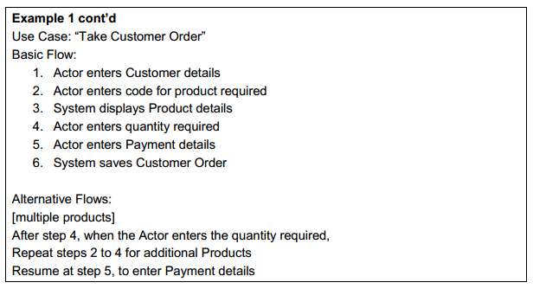
Functional model: Use cases diagram
This is a use case specification

Slide 41
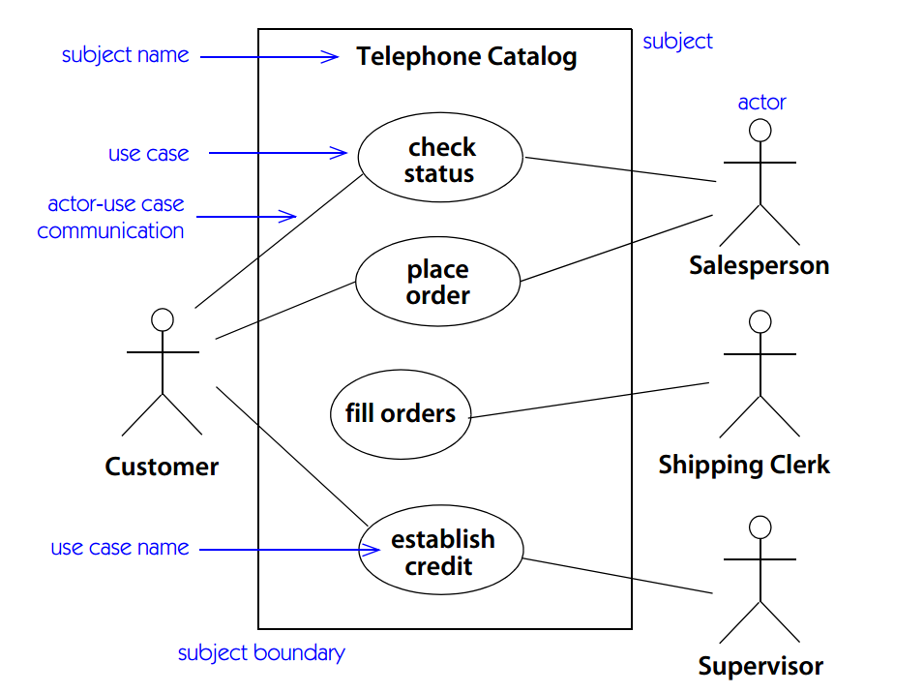
Functional model: Use cases diagram

Slide 42
Functional model: Use cases diagram
Actor
An actor is an entity that interacts with the system

Slide 43
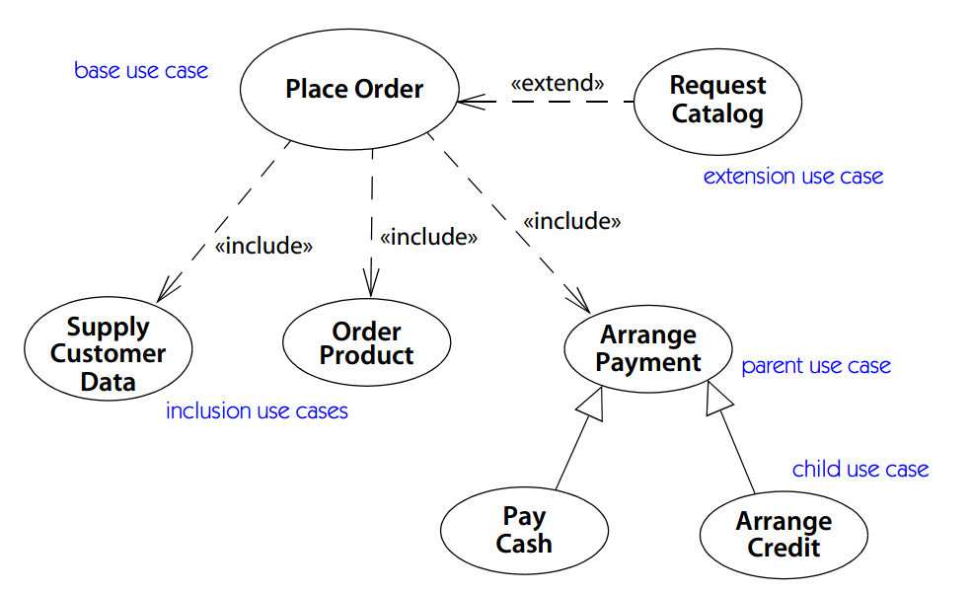
Functional model: Use cases diagram

Slide 44
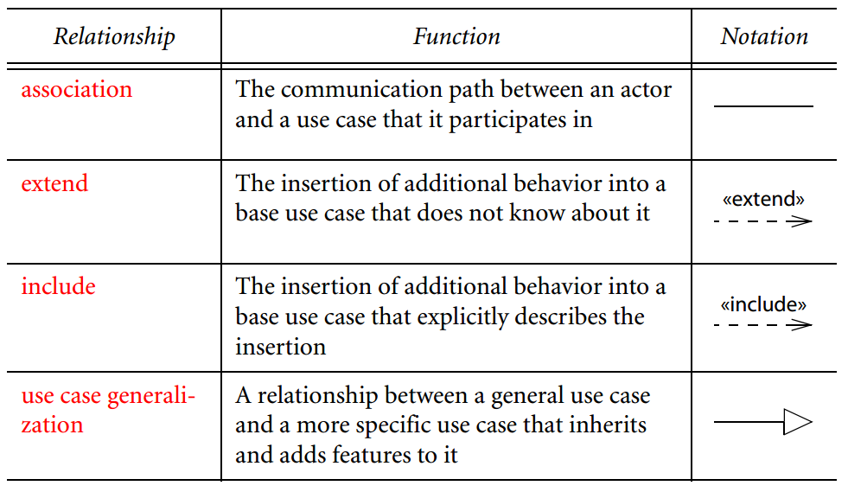
Functional model: Use cases diagram

Slide 45
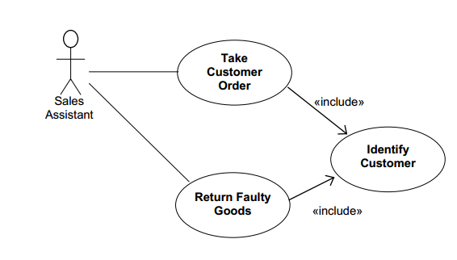
Functional model: Use cases diagram: include
Includes the steps from one use case into another

Slide 46
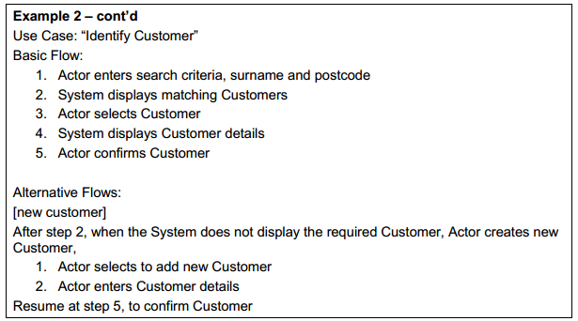
Functional model: Use cases diagram: include
Includes the steps from one use case into another

Slide 47
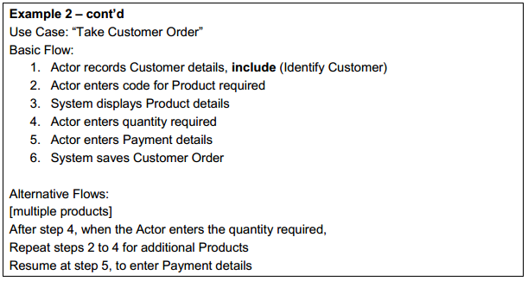
Functional model: Use cases diagram: include
Includes the steps from one use case into another

Slide 48
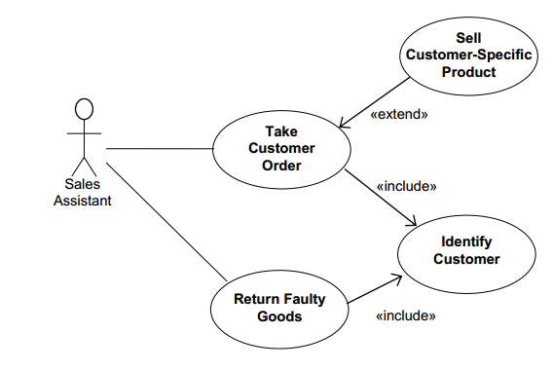
Functional model: Use cases diagram: extends
Allows to modify the behavior of the base use case

Slide 49
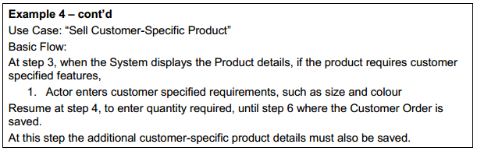
Functional model: Use cases diagram: extends
Allows to modify the behavior of the base use case

Slide 50
Functional model: Use cases diagram: generalization
Allows to replace the behavior of the base use case.
Is more a theoretical relationship
Many people finds hard to understand
For now keep the include and extends in mind

Slide 51
Object Model:
Class diagram
Also known as static view
This diagram captures the object structure. Includes all the data structures and the operations on the data
It does not contains any information related to the dynamic behavior

Slide 52
Object Model:
Class diagram
Also known as static view
This diagram captures the object structure. Includes all the data structures and the operations on the data
It does not contains any information related to the dynamic behavior
Run time

Slide 53
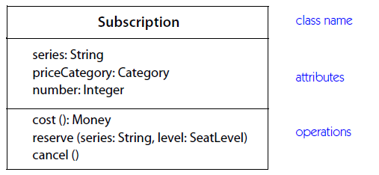
Object Model:
Class diagram
A class is represented as:

Slide 54
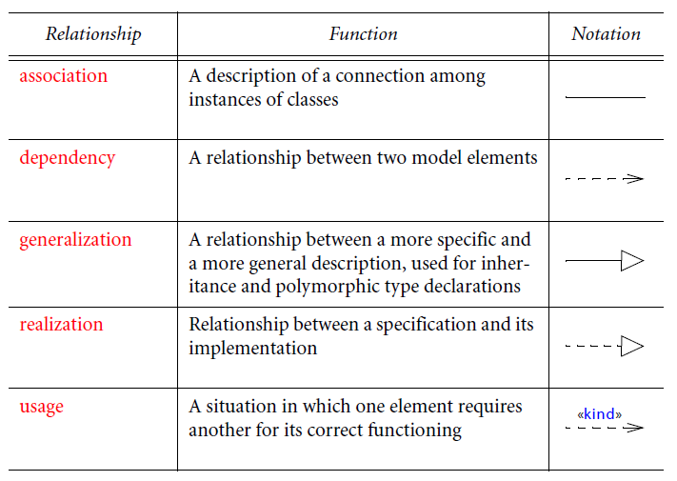
Object Model:
Class diagram

Slide 55
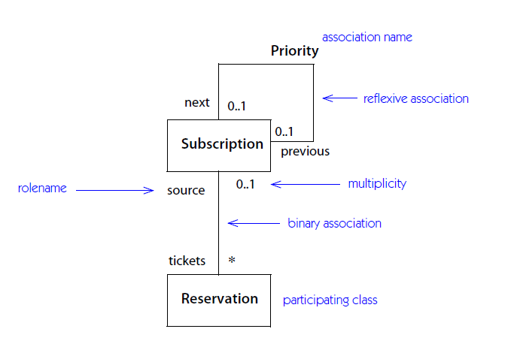
Object Model:
Class diagram: Association

Slide 56
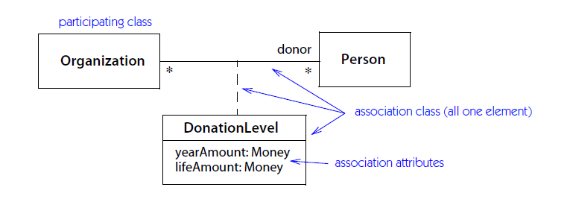
Object Model:
Class diagram: Association

Slide 57
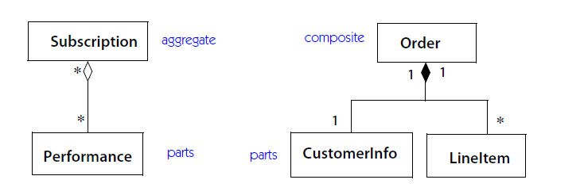
Object Model:
Class diagram: Association

Slide 58
Object Model:
Class diagram: Association
What is the difference between aggregate and composite?
Depends if the enclosed object is stand alone or not.
If the object is stand alone, it is an aggregate
If the object depends on the container to live, is composite

Slide 59
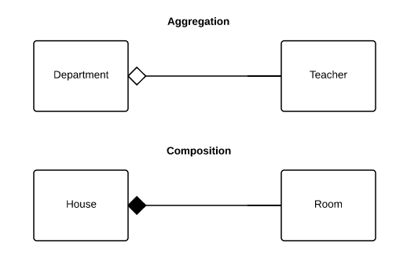
Object Model:
Class diagram: Association

Slide 60
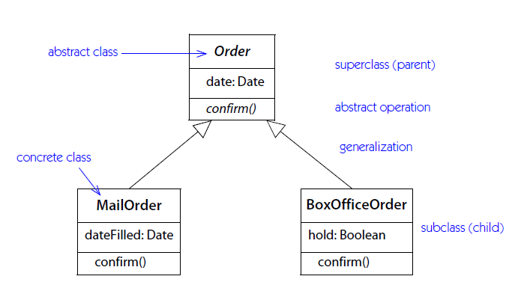
Object Model:
Class diagram: Generalization

Slide 61
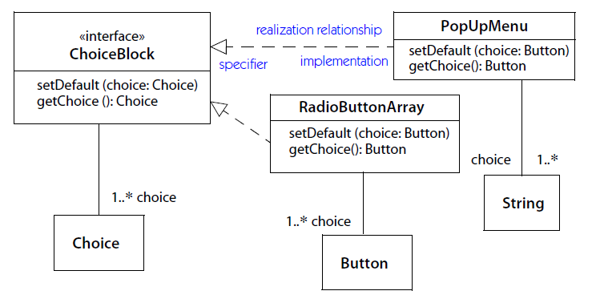
Object Model:
Class diagram: Realization

Slide 62
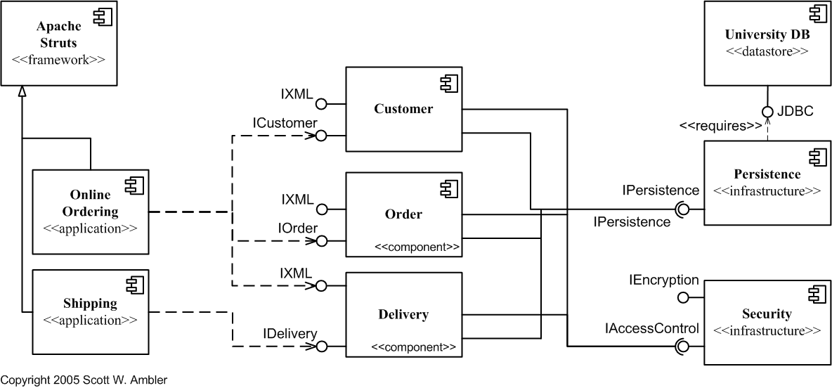
Object Model: Component diagram

Slide 63
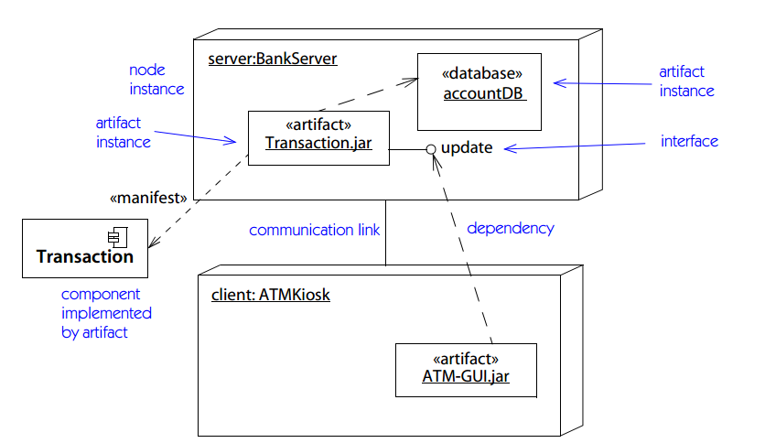
Object Model: Deployment diagram

Slide 64
Dynamic Model: Sequence diagram
Sequence diagrams are used to formalize the dynamic behavior of the system and to visualize the object communication

Slide 65
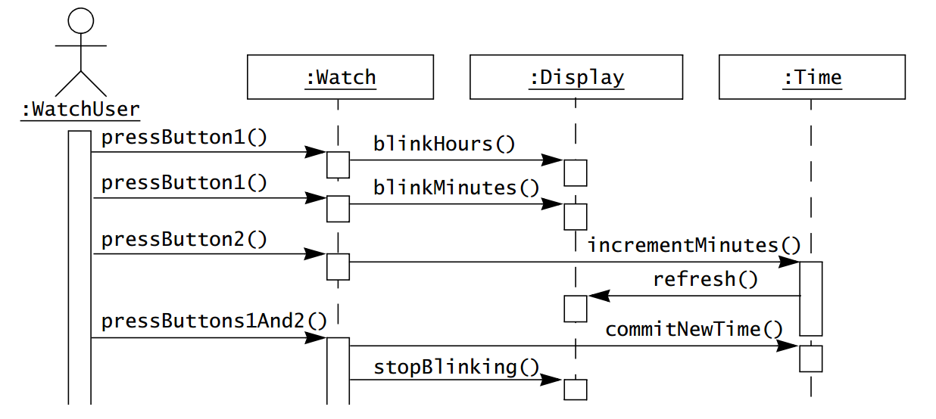
Dynamic Model: Sequence diagram

Slide 66

Further readings...

Slide 67

The message is...
Be an engineer! Avoid staying in the empirical side of things
Model the problem before starting to code!
Think!
Be formal!

Slide 68
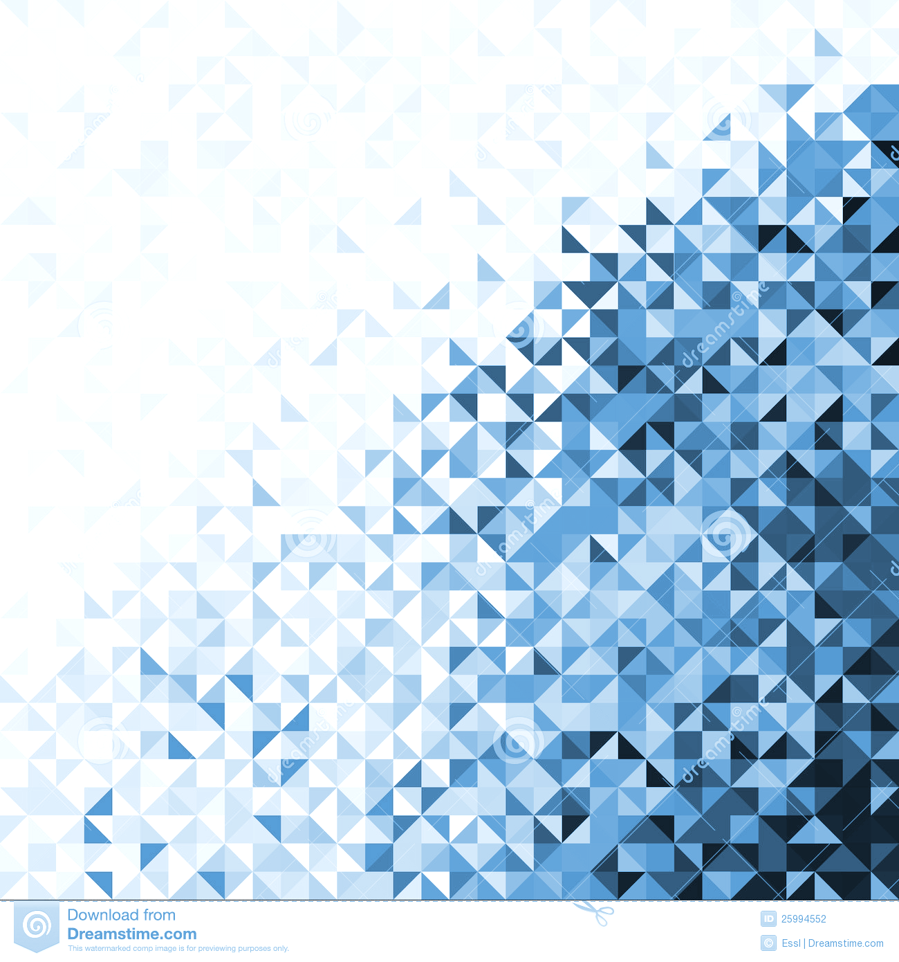
Design Patterns

Slide 69
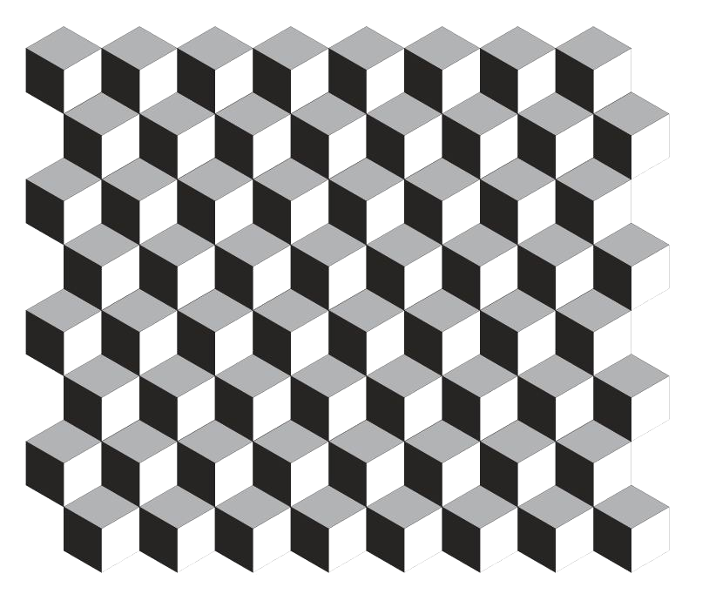

What is a pattern?

Slide 70
What is a pattern?
This image is partially visible

Slide 71
What is a pattern?
Can you tell what is behind the squares?

Slide 72
What is a pattern?
How did you do it?
That was easy!

Slide 73
What is a pattern?
Is a discernible regularity in the world or in a manmade design - Wikipedia
One thing an expert designer know not to do is solve every problem from first principles
Why?
Does this make sense to you?
Have you heard the old saying: don’t reinvent the wheel?

Slide 74
What is a pattern?
Experts designers reuse solutions that have worked for them in the past
Base new designs on prior experience

Slide 75
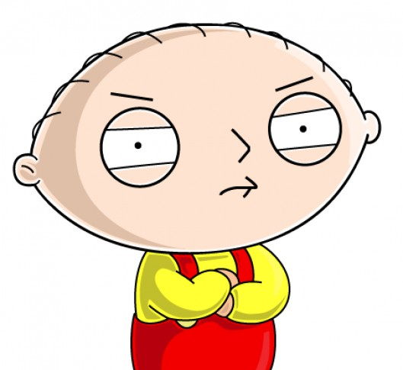
What is a pattern?
Experts designers reuse solutions that have worked for them in the past
Base new designs on prior experience
But every problem is unique!!

Slide 76
What is a pattern?
Experts designers reuse solutions that have worked for them in the past
Base new designs on prior experience
Experience will let you know when a solution applies or not
But every problem is unique!!
Not every known solution applies for all problems

Slide 77
Design patterns in the OOP context
Is a general reusable solution to a commonly occurring problem with a given context in software design
A pattern contains a description of communicating objects and classes that are customized to solve a general design problem in a particular context

Slide 78
Design patterns in the OOP context
A pattern can be thought as a good practice, a proven solution for a problem
Design patterns are usually known by many software professionals across the world.

Slide 79
Design patterns in the OOP context
Each pattern has the following elements:
Name
Problem
Solution
Consequences
Name: is a shortcut to describe the pattern in a word or two
Increases our vocabulary
Allows to communicate in common terms with others

Slide 80
Design patterns in the OOP context
Problem: describes when to apply the pattern. Explains the problem and its context
Describe the symptoms of an inflexible design
Solution: describes the elements that make up the design, their relationship, responsibilities and collaborations

Slide 81
Design patterns in the OOP context
Consequences: results and trade-off of applying a pattern
Critical for evaluating design alternatives
Understand costs and benefits

Slide 82
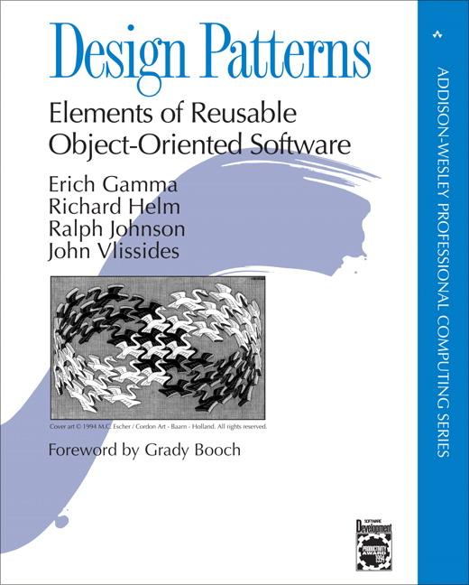
Design patterns: History background
The first catalog of design patterns was recompiled in 1994 by “the gang of four”:
Erich Gamma
Richard Helm
Ralph Johnson
John Vlissides

Slide 83
Design patterns: History background
They recompile best practices known informally by many engineers
Also they proposed patterns designed by themselfs
The book has become a classic and a reference for all software engineers

Slide 84
Design patterns: Categories
Patterns can be classified by two criteria: purpose and scope.
Purpose reflect what a pattern does
Scope specifies if the pattern applies to classes or objects

Slide 85
Design patterns: Categories
Patterns can be classified by two criteria: purpose and scope.
Purpose reflect what a pattern does
Scope specifies if the pattern applies to classes or objects

Slide 86
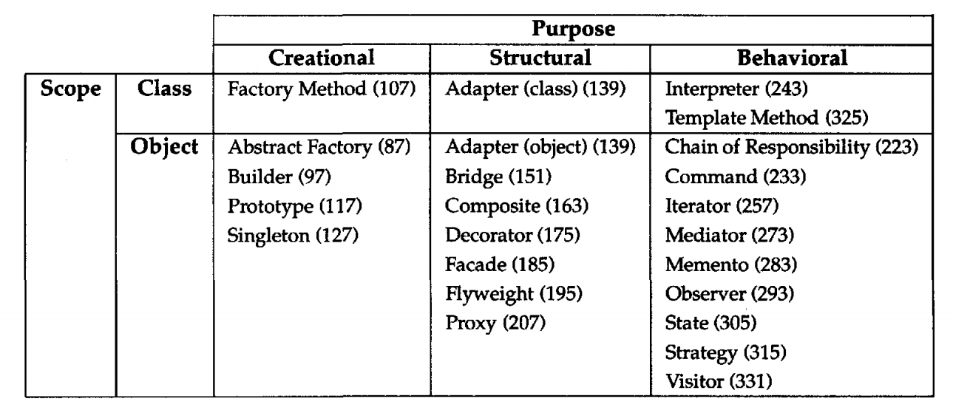
Design patterns: Categories

Slide 87
Design patterns: Categories
Concerns the process of object creation

Slide 88
Design patterns: Categories
Deals with the composition of classes or objects

Slide 89
Design patterns: Categories
Characterize the ways in which classes or objects interact and distribute responsibility

Slide 90
Design patterns: Categories
Deal with relationship between classes and subclases

Slide 91
Design patterns: Categories
Deal with relationship between objects which can be changed in run-time

Slide 92
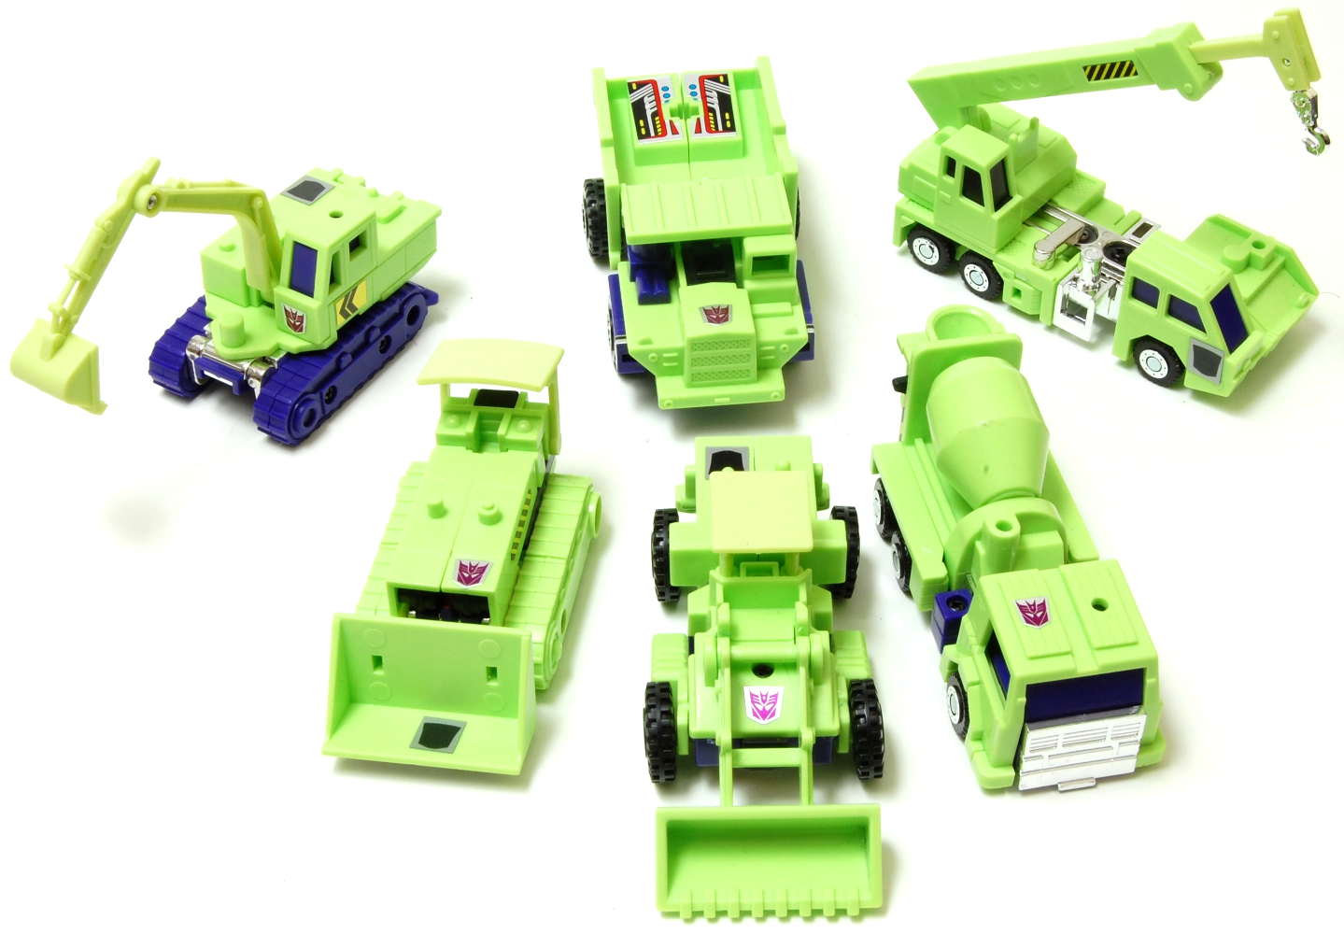
Creational patterns
Abstracts the instantiation process
Help make a system independent of how its objects are created, composed and represented.

Slide 93
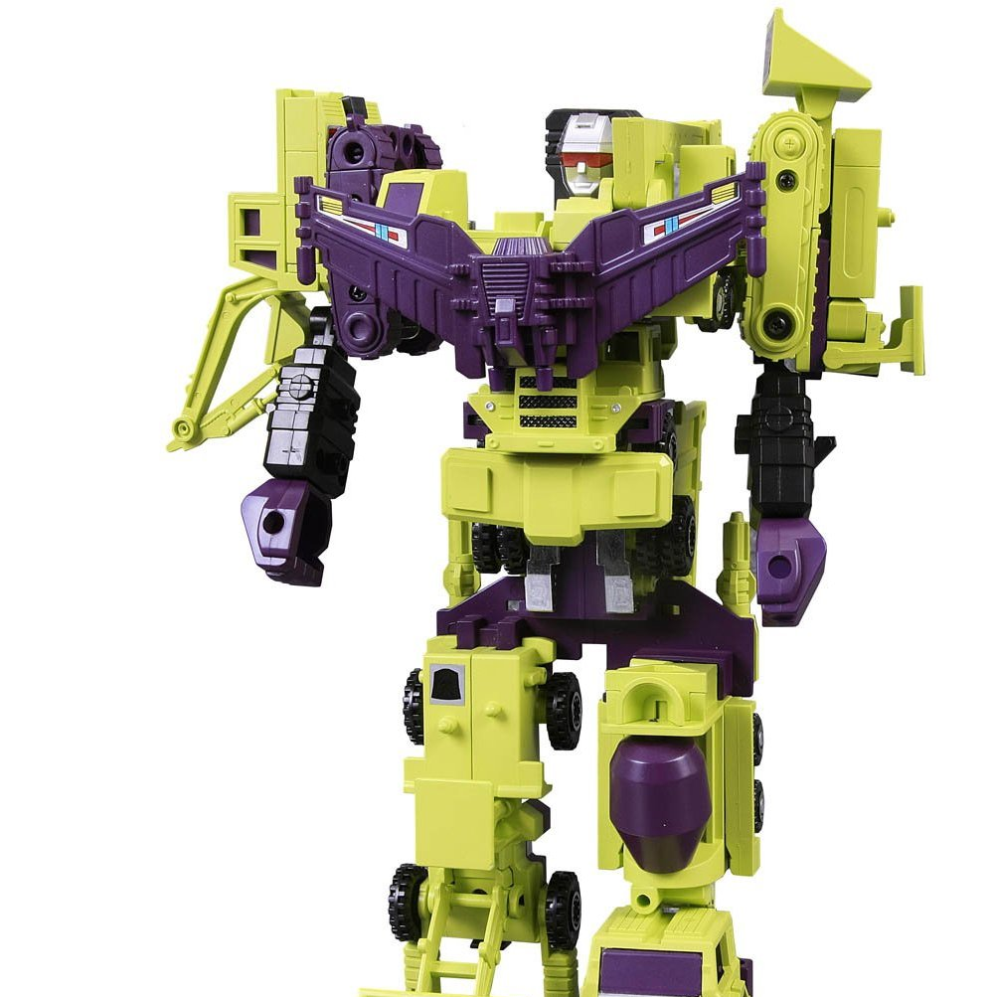
Creational patterns
Two main focuses:
Encapsulates the knowledge about which concrete classes the system uses
Hides how instances of the classes are created and put together

Slide 94
Creational Pattern: Builder
Purpose:
"Separate the construction of a complex object from its representation so that the same construction process can create different representations."

Slide 95
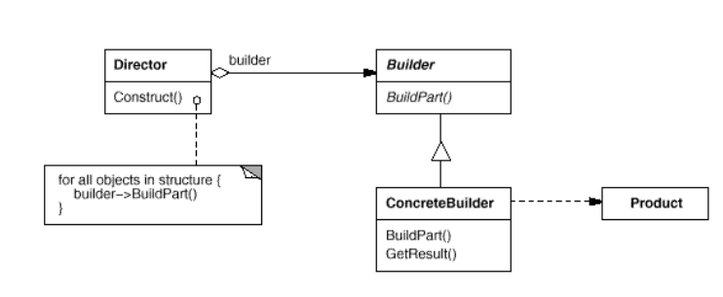
Creational Pattern: Builder
Structure:

Slide 96
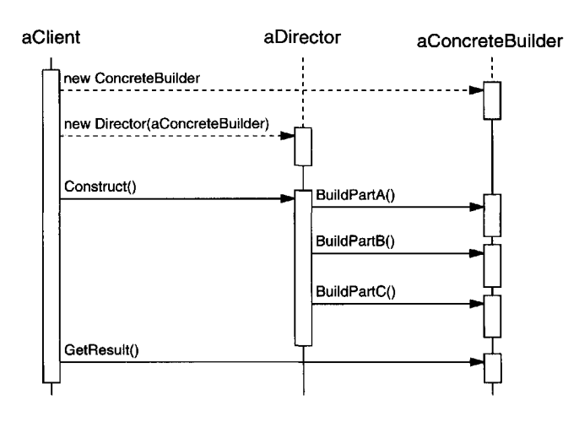
Creational Pattern: Builder
Collaborations:

Slide 97
Creational Pattern: Builder
Collaborations:
Creates the Director and configures it with the desired Builder Object

Slide 98
Creational Pattern: Builder
Directs the assembly process of the whole. Relies on the builder
Collaborations:

Slide 99
Creational Pattern: Builder
Collaborations:
Handles requests from the director and adds parts to the product

Slide 100
Creational Pattern: Builder
Collaborations:
Retrieves the whole product

Slide 101
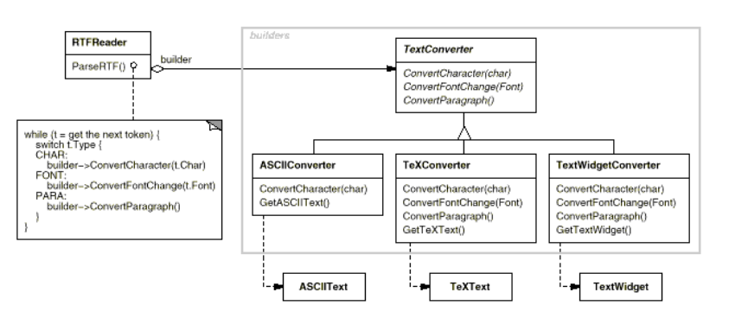
Creational Pattern: Builder
Example:

Slide 102
Creational Pattern: Builder
Apply it when:
The algorithm for creating a complex object should be independent of the parts that make up the object and how they're assembled.
The construction process must allow different representations for the object that's constructed.

Slide 103
Creational Pattern: Builder
Consequences:
It lets you vary a product's internal representation
The builder can hide the internal structure of the product
Hides how the product gets assembled
A new builder is all that is need to chance the internals of the product

Slide 104
Creational Pattern: Builder
Consequences:
It isolates code for construction and representation
Hides the way a complex object is constructed and represented
Clients don’t need to know anything about the classes that define the product’s internal structure
Different directors can reuse builders

Slide 105
Creational Pattern: Builder
Consequences:
It gives you finer control over the construction process
Creates the product step by step under the control of the director
The director retrieves the product only when it is finished

Slide 106
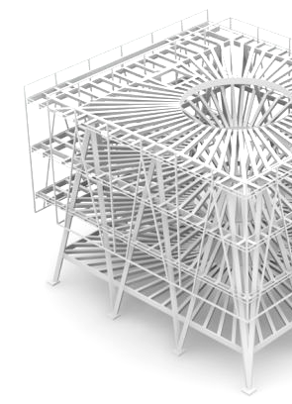
Structural patterns
Are concerned with how classes and objects are composed to form larger structures
Describe ways to compose objects to realize new functionalities
Change composition at run-time

Slide 107
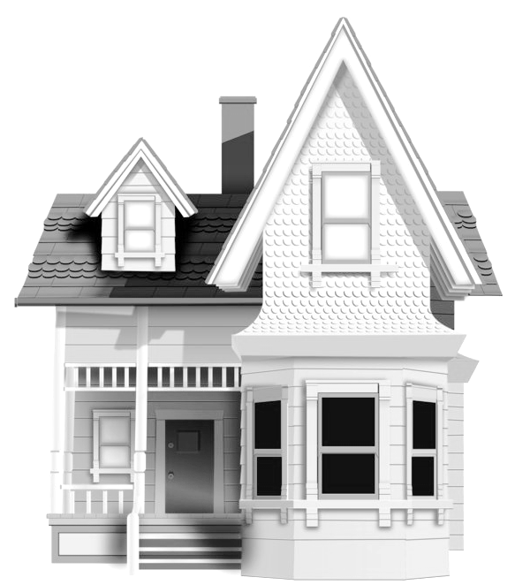
Structural Patterns: Facade
Purpose:
"Provide a unified interface to a set of interfaces in a subsystem. Facade defines a higher level interface that makes subsystem easier to use"

Slide 108
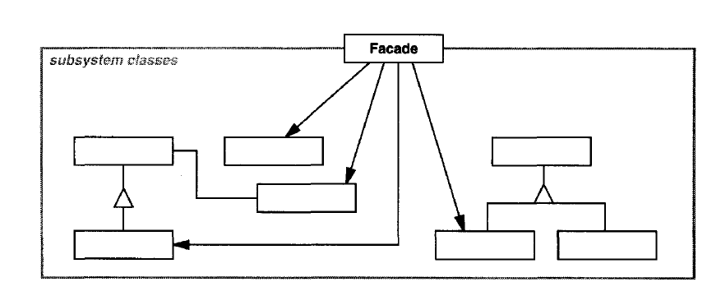
Structural Patterns: Facade
Structure:

Slide 109
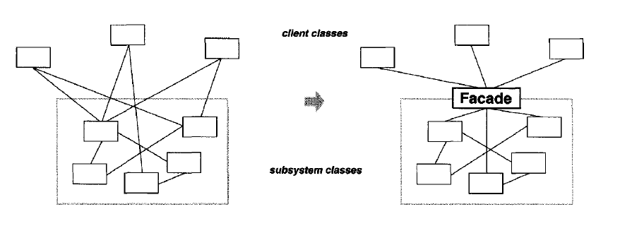
Structural Patterns: Facade
Structure:

Slide 110
Structural Patterns: Facade
Collaborations:
Clients communicate with the subsystem by sending request to Facade, which forwards to the appropriate subsystem objects
Clients that use the facade don't have access to its subsystem objects directly

Slide 111
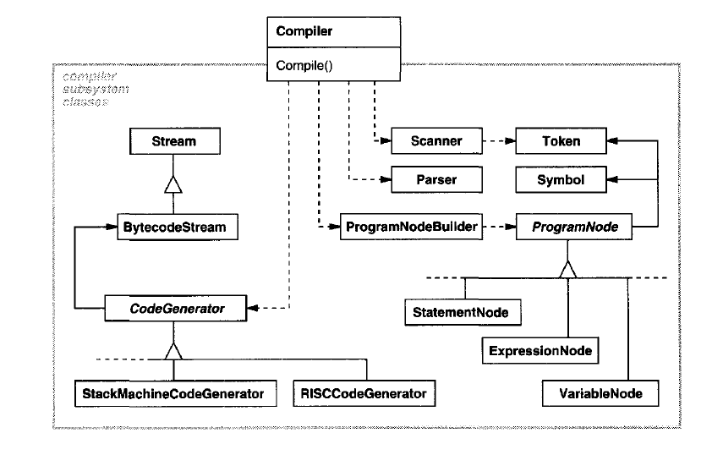
Structural Patterns: Facade
Example:

Slide 112
Structural Patterns: Facade
Apply it when:
You want to provide a simple interface to a complex subsystem
You want to give a simple default view of the subsystem that is good enough for the clients
There are many dependencies between clients and the implementation classes. Facade decouples the subsystem from clients
You want to define an entry point to a subsystem while hiding complexity

Slide 113
Structural Patterns: Facade
Consequences:
Shields client from the subsystem components, making the subsystem easier to use
Promotes weak coupling between clients and subsystems
Don't prevent clients from using subsystem classes directly

Slide 114
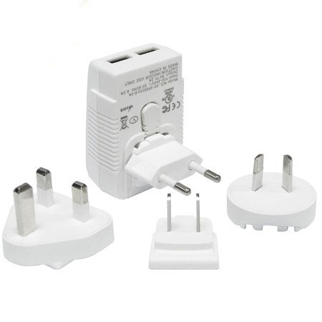
Structural Patterns: Adapter
Purpose:
"Convert the interface of a class into another interface clients expect. Adapter lets classes work together that couldn't otherwise because of incompatible interfaces."

Slide 115
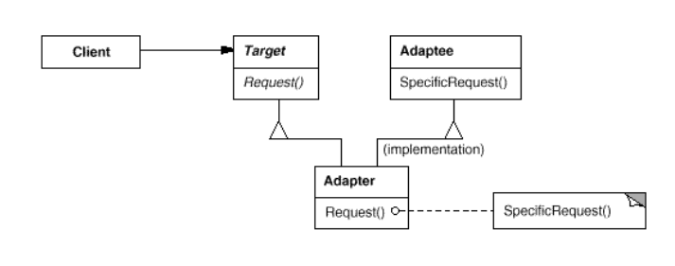
Structural Patterns: Adapter
Structure:
Class level

Slide 116
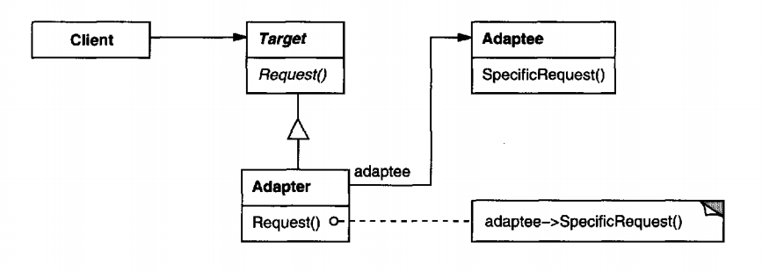
Structural Patterns: Adapter
Structure:
Object level

Slide 117
Structural Patterns: Adapter
Collaborations:
Clients call operations on an Adapter instance. In turn the adapter calls adaptee operations that carry out the request

Slide 118
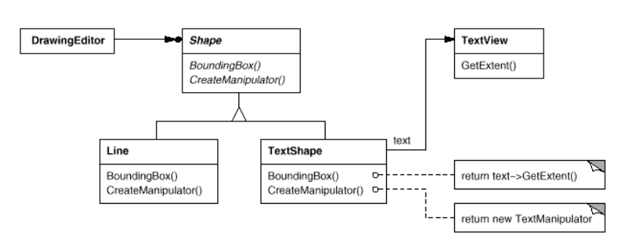
Structural Patterns: Adapter
Example:

Slide 119
Structural Patterns: Adapter
Apply it when:
You want to use an existing class, and its interface does not match the one you need.
You want to create a reusable class that cooperates with unrelated or unforeseen classes, that is, classes that don't necessarily have compatible interfaces.
(object adapter only) You need to use several existing subclasses, but it's impractical to adapt their interface by subclassing everyone.

Slide 120
Structural Patterns: Adapter
Consequences on class adapter:
Won't work when we want to adapt a class and all its subclasses
Lets override some of Adaptee's behavior
Consequences on object adapter:
The Adapter can also add functionality to all adaptees (all subclasses) at once.
Harder to override adaptee behavior

Slide 121

Behavioral Patterns
Are concerned with algorithms and the assignment of responsibilities between objects
Describe the patterns of communication between classes or objects
Let you concentrate on the interconnection between objects

Slide 122
Behavioral Patterns: Observer
Purpose:
"Define a one-to-many dependency between objects so that when one object changes state, all its dependents are notified and updated automatically"

Slide 123
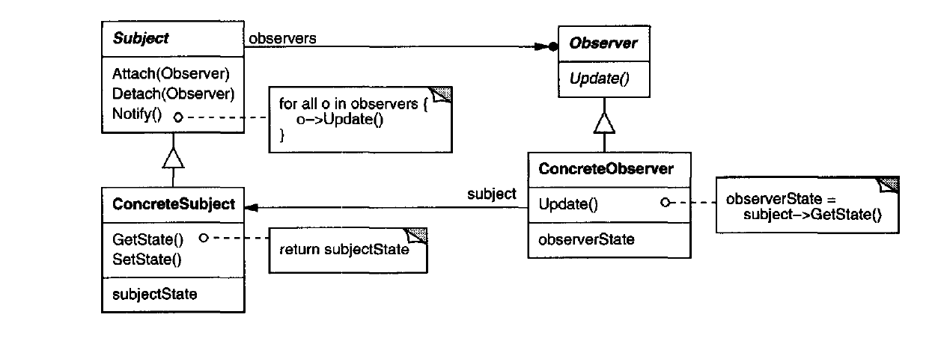
Behavioral Patterns: Observer
Structure:

Slide 124
Behavioral Patterns: Observer
Collaborations:
ConcreteSubject notifies its observers whenever a change occurs that could make its observers' state inconsistent with its own
After being informed of a change in the concrete subject, a ConcreteObserver may query the subject for information

Slide 125
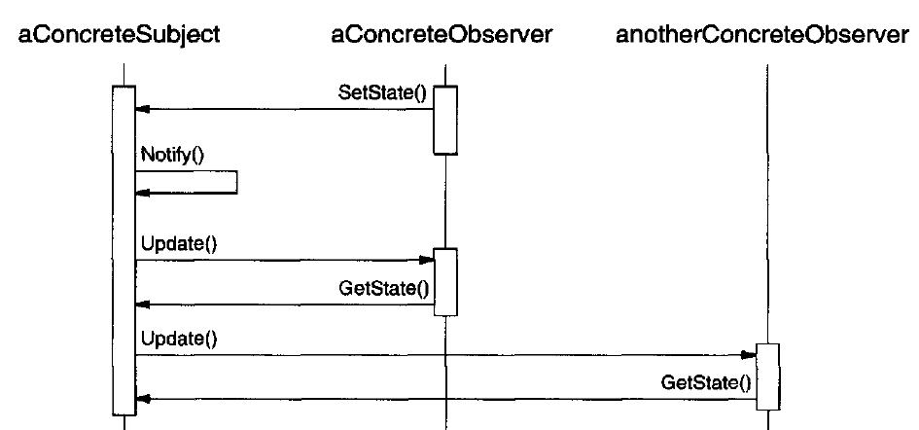
Behavioral Patterns: Observer
Collaborations:

Slide 126
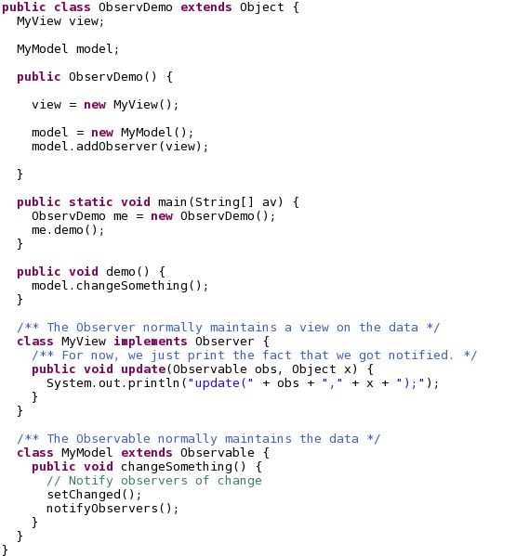
Behavioral Patterns: Observer
Example:

Slide 127
Behavioral Patterns: Observer
Apply when:
An abstractions has two aspects: one dependent on the other
A change to one object requires changing others and you don't know how many others are
An object should be able to notify other objects without making assumptions who they are

Slide 128
Behavioral Patterns: Observer
Consequences:
Decouples subject and observer
Supports broadcast communication
Unexpected updates: observers have no knowledge of each other's presence they don't know the cost of each change for the overall system
Is hard for observers know what changed

Slide 129
Behavioral Patterns: Chain of Responsibility
Purpose:
"Avoid coupling the sender of a request to its receiver by giving more than one object a chance to handle the request. Chain the receiving objects and pass the request along the chain until an object handles it."

Slide 130
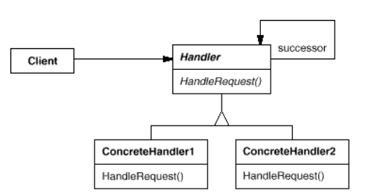

Behavioral Patterns: Chain of Responsibility
Structure:

Slide 131
Behavioral Patterns: Chain of Responsibility
Collaborations:
When a client issues a request, the request propagates along the chain until a concrete handler object takes responsibility for handling it

Slide 132

Behavioral Patterns: Chain of Responsibility
Example:

Slide 133
Behavioral Patterns: Chain of Responsibility
Apply when:
More than one object may handle a request, and the handler isn't known a priori. The handler should be ascertained automatically.
You want to issue a request to one of several objects without specifying the receiver explicitly.
The set of objects that can handle a request should be specified dynamically.

Slide 134
Behavioral Patterns: Chain of Responsibility
Consequences
Reduced coupling:
Frees an object from knowing which other object handles a request.
The sender and receiver have no explicit knowledge of each other, and the object in the chain doesn’t know about the chain structure

Slide 135
Behavioral Patterns: Chain of Responsibility
Consequences
Added flexibility in assigning responsibilities to objects
Distributes responsibilities among objects
You can add/remove responsibilities for handling a request by adding or changing the chain at run-time

Slide 136
Behavioral Patterns: Chain of Responsibility
Consequences
Receipt isn't guaranteed
Since a request has no explicit receiver, there is no guarantee it’ll be handled

Slide 137
How to select a design pattern?
Consider how the pattern solve a design problem
What do you want to solve? Granularity? Coupling? Flexibility? Design for change?
Think on what you may want to change later without having to redesign
Encapsulate the concept that varies

Slide 138
Design patterns
Why do we need design patterns?

Slide 139


Slide 140
What about the other patterns?
Homework:
Select at least three patterns, do a recording explaining each of them that includes:
Purpose
Structure
Consequences
Scenarios where the pattern is applicable
Code sample in Java and C++
More details will be sent to the group

Slide 141

Software Product Quality
An introduction

Slide 142
Before we start...
Why is this topic software product quality?
Software quality may refer to two different things:
Quality in the process of creating software
Quality in the software product

Slide 143

Before we start...
What is QA?
What is QC?
What is Testing?

Slide 144
Before we start...
Many times QA, QC and testing are terms used interchangeable
But they are not the same!

Slide 145
Before we start...
QA is quality assurance
Quality assurance is a set of activities designed to ensure that the development or maintenance process is adequate to ensure a system will meet its objectives

Slide 146
Before we start...
QC is quality control
Quality control is a set of activities designed to evaluate a developed work product
Testing is one of the quality control activities. Is the process of executing a system with the intent of finding defects

Slide 147
Before we start...
You will see many job descriptions marked as QA when the role really is only testing
Many people say they are “QA Engineers” when they should be saying they are “Testers”
“QA Engineer” sounds better than “Tester”

Slide 148
Before we start...
QA & QC are both essential achieve software quality
Applying only QA we may have optimized processes to create quality software, but we will never check if the product really have the quality we want

Slide 149
Before we start...
Likewise, applying on QC is simply conducting tests without any vision on how to avoid defects during the process
So remember:
QA is the process of managing for quality
QC is used to verify quality of the output
Testing is one of the many techniques involves in QC

Slide 150
What is quality?
ISO defines quality as the degree to which a set of inherent characteristics fulfills requirements
Functional requirements
Non-functional requirements
There are many formal specifications/standards related to software quality

Slide 151

ISO/IEC 9126-1 Software Quality
Generally accepted software quality standard
The fundamental objective is to address some of the well known human biases that can adversely affect the delivery and perception of a software development project

Slide 152
ISO/IEC 9126-1 Software Quality
Divided in four parts:
Quality model
Internal metrics
External metrics
Quality in use metrics
Focused on the product not in the process
But this doesn’t mean is not important for QA

Slide 153
ISO/IEC 9126-1 Software Quality
The quality model defines internal and external quality attributes
Internal is related to the software structure, architecture, code: static attributes

Slide 154
ISO/IEC 9126-1 Software Quality
External is related to how the software behaves under certain circumstances

Slide 155

ISO/IEC 9126-1 Software Quality

Slide 156
ISO/IEC 9126-1 Software Quality
How well software provides desired functions

Slide 157
ISO/IEC 9126-1 Software Quality
How well software maintains the level of performance

Slide 158
ISO/IEC 9126-1 Software Quality
How well software can be understood, learned by the user

Slide 159
ISO/IEC 9126-1 Software Quality
How well software provides performance relative to the resources

Slide 160
ISO/IEC 9126-1 Software Quality
How well software can be maintained

Slide 161
ISO/IEC 9126-1 Software Quality
How well software can be ported from one to another environment

Slide 162
ISO/IEC 9126-1 Software Quality
How do we know if we are fulfilling each characteristic?

Slide 163
ISO/IEC 9126-1 Software Quality
Metrics can be applied and give a diagnostic for each characteristic
For each characteristic, there are a set of metrics.
How do we know if we are fulfilling each characteristic?

Slide 164


Slide 165
Not that kind of metric!...but yep..it works...

Slide 166
ISO/IEC 9126-1 Software Quality
Many people forgets about this...they forget the truth about software

Slide 167

The truth about software...
A new system is most of the time:
Easy to control
Have a clean and neat design
Most of the people involved have a clear understanding of the code, components and the whole system
Defects are solved very quick
Nobody is afraid of the system!

Slide 168
The truth about software...
As time goes by:
A lot of hot fixes
Running to meet unrealistic schedules
Bad design decisions are made
Programmers code just to finish their work ASAP
Software starts degrading

Slide 169

The truth about software...
Things change:
High complexity
Low maintainability
Changes are expensive, risky and slow
The system is a mystery to the programmers
Nobody wants to touch them, only a few brave ones

Slide 170

The truth about software...
What can we do to avoid software to become a terrorific monster?
Software is a living being. Don’t forget that!
Aiming for maintainability can be a good shield against evil software!

Slide 171

The truth about software...
Software easily “rots”
Avoiding the rotting is very hard, but creating software that is less prone to rotting is not that hard.
We’ll talk more about this later...now testing!

Slide 172
Testing
Is the process of executing a program with the intent of finding errors
Sometimes testing is the last part of a large development process, and sometimes the time for testing is took to finish coding instead

Slide 173
Testing
People often avoid testing thinking that is too expensive in time and money
If you don’t test your code, you are leaving potential errors that are going to be even more expensive
The mindset should be: invest money and time now, instead of investing even more money and time later!

Slide 174
Testing
Test-lazy people can find a great help following Test-Driven Development
Code tests first even before the real code
There are two main types of tests:
Black box
White box

Slide 175
Black box testing
View the program as a black box: you don’t know what is inside
Your goal is be completely unconcerned about the internal behavior and structure of the program
Concentrate on finding circumstances in which the program does not behave according to the specifications

Slide 176

Black box testing

Slide 177
Black box testing
If I don’t know what is inside, how do I know how to test it?

Slide 178
Black box testing
Test data is designed based on the specification of the program
To find errors in the program the criterion is exhaustive input testing
Make use of every possible input
This is almost impossible
Focus on maximizing the number of errors found with a finite set of test cases

Slide 179

White box testing
Also called logic-driven testing
Permits you to examine the internal structure of the program
Derives the test data from an examination of the program's logic and structure

Slide 180
White box testing
Focus on executing most (if not all) of the code at least once
Test all possible paths of control flow of the program

Slide 181

White box testing
High complexity can make testing virtually impossible

Slide 182
Testing
Inside this white/black box categories, there are many types of tests:
Installation
Compatibility
Regression
Acceptance
Alpha
Beta
Functional
Accessibility
Security

Slide 183
Testing
Also there are different levels to which the tests are applied:
Unit testing
Integration testing
Component interface testing
System testing
Sometimes the line between these definitions becomes blurry

Slide 184
Unit Testing
Unit testing is all about white box. Is focused on testing a module of the software
Isn't a new concept, is around since the 70s
Is a proven technique to improve the quality of the code while gaining deeper knowledge of the functional requirements

Slide 185
Unit Testing
An unit test is:
A piece of code (usually a method) that invokes another piece and checks the correctness of some assumptions afterward
If the assumptions turn out to be wrong the unit test has failed
A "unit" is a method or function

Slide 186
Unit Testing
A good unit test should be:
Automated and repeatable
Easy to implement
Once it is written, it should remain for future use
Anyone should be able to run it
It should run at the push of a button
It should run quickly
If lacks one of these, then it is not an unit test

Slide 187

Unit Testing

Slide 188
Unit Testing
There is a better way to code unit tests
xUnit is a collection of unit testing frameworks that derives Smalltalk's SUnit
For C++ there are many xUnit frameworks. For now we will use CppUnit

Slide 189
Going back to maintainability
We talk before how the software "rots" and that it happen very easily and without even notice it
But there are some "smells" that can let you know when the software is starting to "rot"

Slide 190

Design "smells"
Rigidity: tendency of software to be difficult to change, even in simple ways
Fragility: tendency of a program to break in many places when a single change is made

Slide 191
Design "smells"
Immobility: parts of the system could be reused, but is very hard and risky to separate those parts
Viscosity: doing the right thing is harder than doing things wrong. Feel more like hacking than coding

Slide 192
Design "smells"
Needless complexity: contains elements that are not currently useful. A lot of nice features that nobody uses
Needless repetition: a lot of repeating structures that could be in just one place

Slide 193
Design "smells"
Opacity: code is really hard to understand and don't express its real intention.

Slide 194

How to avoid design "smells"
There are a set of design principles that sets the bases prolong the life of the software without "rotting"
That will be your homework...

Slide 195

Today's fact:
Framework vs Toolkit
Geek Corner "Fun" facts for geeks
Those two terms are used a lot in the software development environment
Sometimes people used them interchangeable, or sometimes people have a hard time understanding the difference
Actually is kind of simple

Slide 196
Today's fact:
Framework vs Toolkit
Geek Corner
Let's put it in a simple way:
When you use a toolkit, you write the main body of the application and call the code of the toolkit that you want to use
When you use a framework, you reuse the main body and write the code it calls. You'll have to follow some code/naming conventions and the framework will call your code.

Slide 197
Today's fact:
Framework vs Toolkit
Geek Corner
A toolkit is a set or related and reusable classes designed to provide useful, general-purpose functionality
Don't impose a particular design to your application
They just provide the functionalities and you decide if you want to use it
Examples of toolkits:
QT
GTK
Java Swing, AWT
Dojo

Slide 198
Today's fact:
Framework vs Toolkit
Geek Corner
A framework is a set of cooperating classes that make up a reusable design for a specific class of software
They dictate the architecture of your application and defines all the design patterns that you have to follow so you can concentrate on the specifics of your application
Design reuse over code reuse.
Examples: AngularJS, .NET, Eclipse RPC, xUnit, Spring, Struts, Rails, Django...

Slide 199
UML, Patterns and Software Quality
CE-2101 Algorithms and Data Structures

